Slide 1
Introduction To Algorithms
CS 445
Discussion Session 8
Instructor: Dr Alon Efrat
TA : Pooja Vaswani
04/04/2005

Slide 2
This Lecture
All-pairs shortest paths
  Johnson’s algorithm
Maximum flow
  Concepts
  Ford-Fulkerson method
  Maximum bipartite matching

Slide 3
Johnson’s Algorithm
What if the graph is sparse?
  If no negative edges – run repeated Dijkstra’s
  If negative edges – let us somehow change the weights of all edges (to w’) and then run repeated Dijkstra’s
Requirements for reweighting:
  Non-negativity: for each (u,v), w’(u,v) ≥ 0
  Shortest-path equivalence: for all pairs of vertices u and v, a path p is a shortest path from u to v using weights w if and only if p is a shortest path from u to v using weights w’.

Slide 4
Choosing reweighting function
How to choose function h?
The idea of Johnson:
  1. Augment the graph by adding vertex s and edges (s,v) for each vertex v with 0 weights.
0
1
0
s
3
-1
-2
0
-1
0
  2. Compute the shortest paths from s in the augmented graph (using Belman-Ford).
  3. Make h(v) = δ (s, v)

Slide 5
Johnson’s algorithm
Why does it work?
  By definition of the shortest path: for all edges (u,v), h(u) ≤ h(v) + w(u,v)
  Thus, w(u,v) + h(u) – h(v) ≥ 0
Johnson’s algorithm:
  1. Construct augmented graph
  2. Run Bellman-Ford (possibly report a negative cycle), to find h(v) = δ (s, v) for each vertex v
  3. Reweight all edges:
    w’(u,v) ← w(u,v) + h(u) – h(v).
  4. For each vertex u:
    Run Dijkstra’s from u, to find δ ’(u, v) for each v
    For each vertex v: D[u][v] ← δ ’(u, v) + h(v) – h(u)

Slide 6
Example
Do the reweighting on this example:

Slide 7
Flow networks
What if weights in a graph are maximum capacities of some flow of material?
  Pipe network to transport fluid (e.g., water, oil)
    Edges – pipes, vertices – junctions of pipes
  Data communication network
    Edges – network connections of different capacity, vertices – routers (do not produce or consume data just move it)
  Concepts (informally):
    Source vertex s (where material is produced)
    Sink vertex t (where material is consumed)
    For all other vertices – what goes in must go out
    Goal: maximum rate of material flow from source to sink

Slide 8
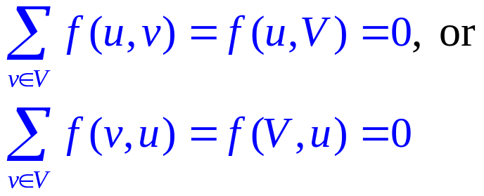
Formalization
How do we formalize flows?
  Graph G=(V,E) – a flow network
    Directed, each edge has capacity c(u,v) ≥ 0
    Two special vertices: source s, and sink t
    For any other vertex v, there is a path s→…→v→…→t
  Flow – a function f : V × V → R
    Capacity constraint: For all u, v ∈ V: f(u,v) ≤ c(u,v)
    Skew symmetry: For all u, v ∈ V: f(u,v) = –f(v,u)
    Flow conservation: For all u ∈ V – {s, t}:

Slide 9
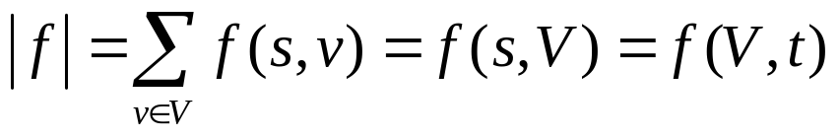
Maximum flow
What do we want to maximize?
  Value of the flow f:
a
13
b
15
8
19
10
10
13
t
s
4
2
9
5
6
5
3
14
c
11
d
3
8
We want to find a flow of maximum value!

Slide 10
Augmenting path
Idea for the algorithm:
  If we have some flow,…
  …and can find a path p from s to t (augmenting path), such that there is a > 0, and for each edge (u,v) in p we can add a units of flow: f(u,v) + a ≤ c(u,v)
  Then just do it, to get a better flow!
  Augmenting path in this graph?
a
13
b
15
19
a
13
b
15
8
19
s
10
9
5
t
10
13
4
s
10
9
5
t
4
2
14
11
3
6
5
3
c
d
14
11
3
c
d
8

Slide 11
The Ford-Fulkerson method
Sketch of the method:
Ford-Fulkerson(G,s,t)
01 initialize flow f to 0 everywhere
02 while there is an augmenting path p do
03 augment flow f along p
04 return f
How do we find augmenting path?
How much additional flow can we send through that path?
Does the algorithm always find the maximum flow?

Slide 12
Residual network
How do we find augmenting path?
  It is any path in residual network:
    Residual capacities: c_{f}(u,v) = c(u,v) – f(u,v)
    Residual network: G_{f}=(V,E_{f}), where
    E_{f} = {(u,v) ∈ V × V : c_{f}(u,v) > 0}
    What happens when f(u,v) < 0 (and c(u,v) = 0)?
    Observation – edges in E_{f} are either edges in E or their reversals: |E_{f}| ≤ 2|E|
Compute residual network:
a
13
b
15
8
19
10
10
13
t
s
4
2
9
5
6
5
3
14
c
11
d
3
8

Slide 13
Residual capacity of a path
How much additional flow can we send through an augmenting path?
  Residual capacity of a path p in G_{f}:
  c_{f}(p) = min{c_{f}(u,v): (u,v) is in p}
  Doing augmentation: for all (u,v) in p, we just add this c_{f}(p) to f(u,v) (and subtract it from f(v,u))
  Resulting flow is a valid flow with a larger value.
  What is the residual capacity of the path (s,a,b,t)?

Slide 14
The Ford-Fulkerson method
Ford-Fulkerson(G,s,t)
01 for each edge (u,v) in G.E do
02 f(u,v) ← f(v,u) ← 0
03 while there exists a path p from s to t in residual network G_{f} do
04 c_{f} = min{c_{f}(u,v): (u,v) is in p}
05 for each edge (u,v) in p do
06 f(u,v) ← f(u,v) + c_{f}
07 f(v,u) ← -f(u,v)
08 return f
The algorithms based on this method differ in how they choose p in step 03.

Slide 15
Cuts
Does it always find the maximum flow?
  A cut is a partition of V into S and T = V – S, such that s ∈ S and t ∈ T
  The net flow (f(S,T)) through the cut is the sum of flows f(u,v), where u ∈ S and v ∈ T
  The capacity (c(S,T)) of the cut sum of capacities c(u,v), where u ∈ S and v ∈ T
  Minimum cut – a cut with the smallest capacity of all cuts
  |f|= f(S,T)
a
13
b
15
9
19
10
10
13
t
s
4
1
9
5
6
1
5
3
14
c
11
d
3
8

Slide 16
Correctness of Ford-Fulkerson
Max-flow min-cut theorem:
  If f is the flow in G, the following conditions are equivalent:
    1. f is a maximum flow in G
    2. The residual network G_{f} contains no augmenting paths
    3. |f| = c(S,T) for some cut (S,T) of G

Slide 17
Edmonds-Karp algorithm
Take shortest path (in terms of number of edges) as an augmenting path – Edmonds-Karp algorithm
  How do we find such a shortest path?
  Running time O(VE²), because the number of augmentations is O(VE)
  To prove this we need to prove that:
    The length of the shortest path does not decrease
    Each edge can become critical at most ~ V/2 times. Edge (u,v) on an augmenting path p is critical if it has the minimum residual capacity in the path:
    c_{f}(u,v) = c_{f}(p)

Slide 18
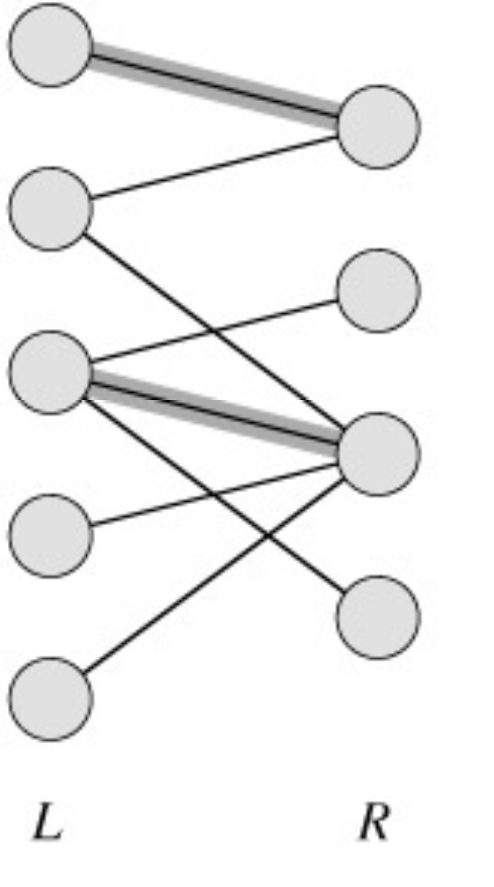
Maximum Bipartite Matching
A bipartite graph is a graph G=(V,E) in which V can be divided into two parts L and R such that every edge in E is between a vertex in L and a vertex in R.
e.g. vertices in L represent skilled workers and vertices in R represent jobs. An edge connects workers to jobs they can perform.

Slide 19
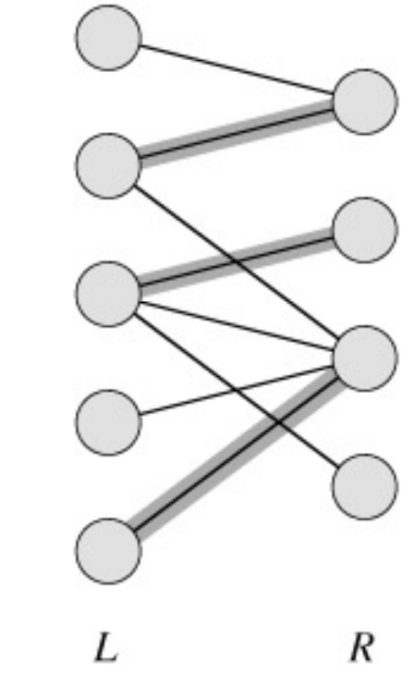
Maximum Bipartite Matching
A matching in a graph is a subset M of E, such that for all vertices v in V, at most one edge of M is incident on v.

Slide 20
Maximum Bipartite Matching
A maximum matching is a matching of maximum cardinality.
maximal
not maximum
maximum

Slide 21
Solving the Maximum Bipartite Matching Problem
Greedy algorithm?
Reduce an instance of the maximum bipartite matching problem on graph G to an instance of the max-flow problem on a corresponding flow network G’.
Solve using Ford-Fulkerson method.

Slide 22
Corresponding Flow Network
To form the corresponding flow network G' of the bipartite graph G:
  Add a source vertex s and edges from s to L.
  Direct the edges in E from L to R.
  Add a target vertex t and edges from R to t.
  Assign a capacity of 1 to all edges.
Claim: max-flow in G’ corresponds to a max-bipartite-matching on G.

Slide 23
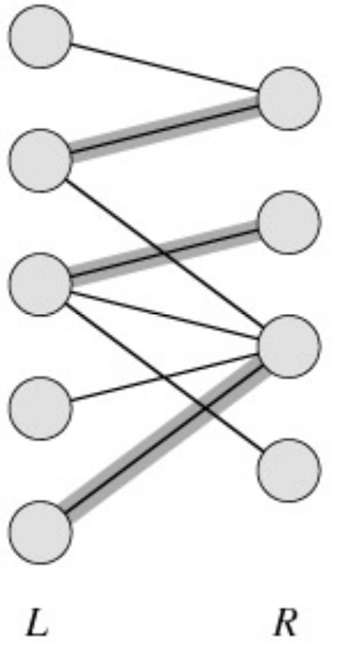
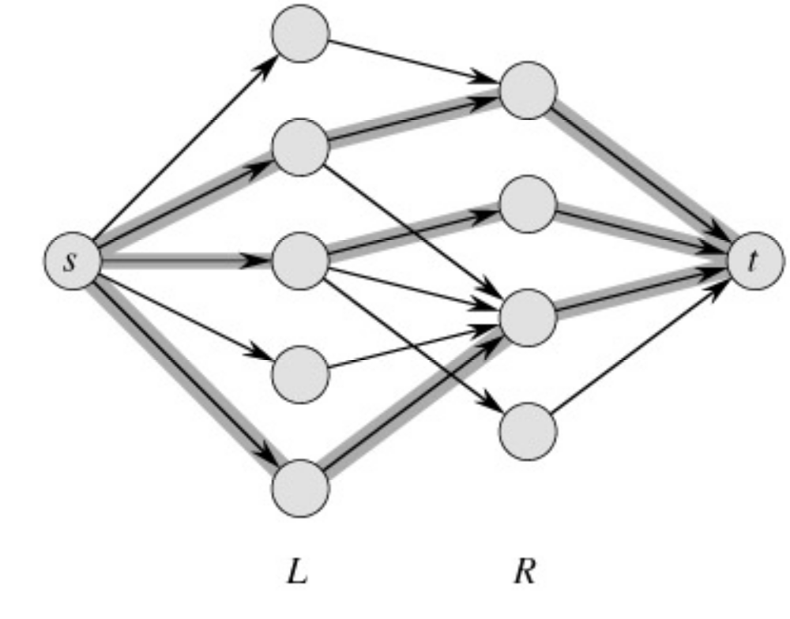
Example
min cut
|M| = 3 ←→ max flow = 3

